Slide 1


Slide 2

Hardware: Electronic Devices
Software: Instructions and Computer Programs

Slide 3

Input : Keyboard, Mouse
System unit:
  Random Access Memory (RAM)
  Central Processing Unit (CPU)
Output: Monitor, Printer
Secondary Storage: Disk Drive

Slide 4

Instructions for the hardware.
  Actions to be performed
A set of instructions is called a program.
  Driving force behind the computer
  Without a program – What is a computer?
    Collection of Useless Hardware
2 purposes:
  Tell the computer what to do
  Tell other people what we want the computer to do.

Slide 5

The central processing unit (CPU)
The “brain” of a computer
Retrieves instructions from memory and executes them.

Slide 6

Stores data and program instructions for CPU to execute
  A program and its data must be brought to memory before they can be executed
Stores intermediate and final results of processing.
Volatile: Contents are erased when computer is turned off or reset.
A memory unit is an ordered sequence of bytes, each holds eight bits. A byte is the minimum storage unit. No two data can share or split the same byte.

Slide 7

Hard Drives, CDs/DVDs, Flash Drives, etc.
Non-Volatile or Permanent Storage
Programs and data are permanently stored on storage devices and are moved to memory when the computer actually uses them.

Slide 8

Digital devices have two stable states, which are referred to as zero and one by convention
The binary number system has two digits, 0 and 1. A single digit (0 or 1) is called a bit, short for binary digit. A byte is made up of 8 bits.
Binary Language: Data and instructions (numbers, characters, strings, etc.) are encoded as binary numbers - a series of bits (one or more bytes made up of zeros and ones)

Slide 9

Encoding and decoding of data into binary is performed automatically by the system based on the encoding scheme
Encoding schemes
  Numeric Data: Encoded as binary numbers
  Non-Numeric Data: Encoded as binary numbers using representative code
    ASCII – 1 byte per character
    Unicode – 2 bytes per character

Slide 10
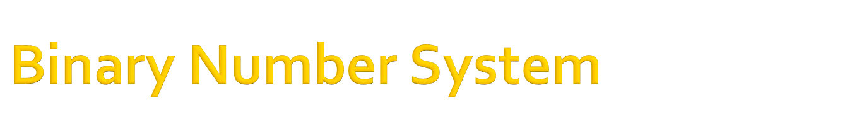
Decimal
  Base 10, ten digits (0-9)
  The position (place) values are integral powers of 10: 10⁰(ones), 10¹(tens), 10²(hundreds), 10³(thousands)…
  n decimal digits - 10^{n} unique values
Binary
  Base 2, two digits (0-1)
  The position (place) values are integral powers of 2: 2⁰(1), 2¹(2), 2²(4), 2³(8), 2⁴(16), 2⁵(32), 2⁶(64)…
  n binary digits - 2^{n} unique values

Slide 11

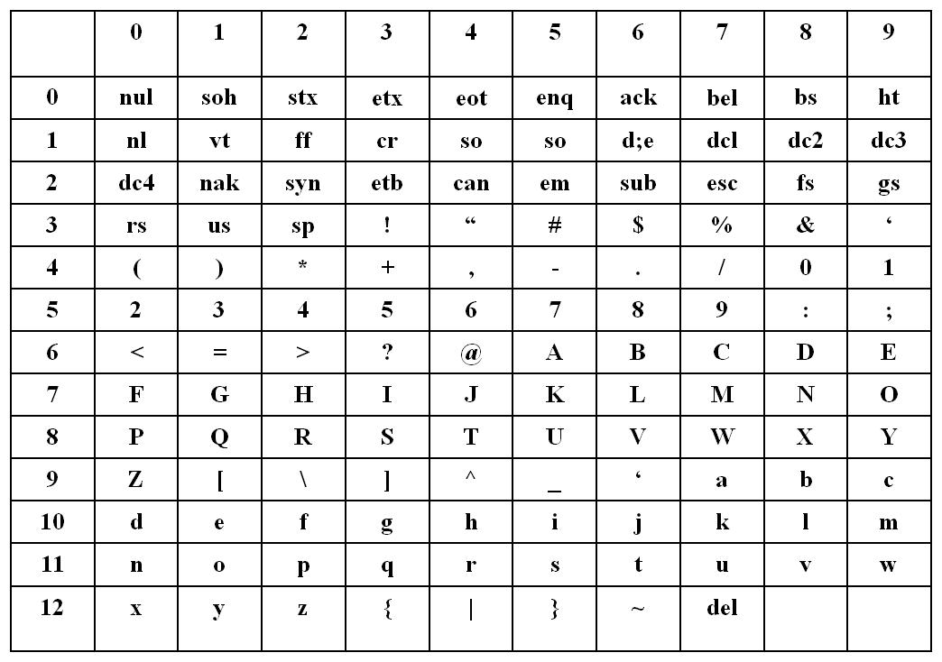

Slide 12

Computers can not use human languages, and programming in the binary language of computers is a very difficult, tedious process
Therefore, most programs are written using a programming language and are converted to the binary language used by the computer
Three major categories of prog languages:
  Machine Language
  Assembly Language
  High level Language

Slide 13

Natural language of a particular computer
Primitive instructions built into every computer
The instructions are in the form of binary code
Any other types of languages must be translated down to this level

Slide 14

English-like Abbreviations used for operations (Load R1, R8)
Assembly languages were developed to make programming easier
The computer cannot understand assembly language - a program called assembler is used to convert assembly language programs into machine code

Slide 15

English-like and easy to learn and program
Common mathematical notation
  Total Cost = Price + Tax;
  area = 5 * 5 * 3.1415;
Java, C, C++, FORTRAN, VISUAL BASIC, PASCAL

Slide 16

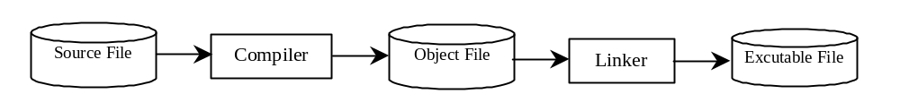
A program written in a high-level language is called a source program (or source code). Since a computer cannot understand a source program. Program called a compiler is used to translate the source program into a machine language program called an object program. The object program is often then linked with other supporting library code before the object can be executed on the machine.

Slide 17

You can port a source program to any machine with appropriate compilers. The source program must be recompiled, however, because the object program can only run on a specific machine. Nowadays computers are networked to work together. Java was designed to run object programs on any platform. With Java, you write the program once, and compile the source program into a special type of object code, known as bytecode. The bytecode can then run on any computer with a Java Virtual Machine. Java Virtual Machine is a software that interprets Java bytecode.

Slide 18

Programming – the creation of an ordered set of instructions to solve a problem with a computer.
Only about 100 instructions that the computer understands - Different programs will just use these instructions in different orders and combinations.
The most valuable part of learning to program is learning how to think about arranging the sequence of instructions to solve the problem or carry out the task

Slide 19

Sequential Processing
  A List of Instructions
Conditional Execution
  Ifs
Repetition
  Looping / Repeating
Stepwise Refinement / Top-Down Design
  Breaking Things into Smaller Pieces
Calling Methods / Functions / Procedures / Subroutines
  Calling a segment of code located elsewhere
  Reuse of previously coded code segment
Notes:
List of Instructions – Remember the Peanut Butter Sandwich, it had to be created in order (sequence)
Ifs – Tasks performed based on a Condition → If it is cold, Wear a Jacket
Repeating Behavior – Jump up and down 3 times. While it is cold wear a jacket
Breaking Things into Smaller Pieces - Take a complicated task and break it down into a list of smaller tasks. We will clean the house → first clean kitchen, then clean bathroom, then clean one bedroom
Compute a Result – Perform the smaller tasks to obtain the result or answer to a question
Programming will use these ideas in various combinations
Only about 100 instructions that the computer understands. Different programs will just use these instructions in different orders and combinations.
The most valuable part of learning to program is learning how to think about arranging the sequence of instructions to solve the problem or carry out the task

Slide 20

Procedural
  Defining set of steps to transform inputs into outputs
  Translating steps into code
  Constructed as a set of procedures
  Each procedure is a set of instructions
Object-Oriented
  Defining/utilizing objects to represent real-world entities that work together to solve problem
  Basic O-O Programming Components
    Class
    Object/Instance
    Properties
    Methods

Slide 21

Class
  Specifies the definition of a particular kind of object
    Its Characteristics : Properties (or Attributes)
    Its Behaviors: Methods
  Used as blueprint / template to create objects of that type
Object/Instance
  A specific instance of a class – an object created using the Class Definition
  All specific instances of the same class share the same definition
    Same Properties – can be modified
    Same Methods – can be modified

Slide 22

CLASS (ALL DOGS)
OBJECT (ONE DOG)
All Instances of Class Dog Have
  Properties
    Name
    Breed
    Weight
    Color
  Methods
    Walk
    Bark
    Jump
A particular Instance Could Have
  Properties
    Name -Spot
    Breed - Mutt
    Weight - 10 pounds
    Color - Black
  Methods
    Walk
    Bark
    Jump
    (these can also be modified to fit a particular dog)

Slide 23

The process of defining a problem, searching for relevant information and resources about the problem, and of discovering, designing, and evaluating the solutions for further opportunities. Includes:
  Finding an Answer to a Question
  Figuring out how to Perform a Task
  Figure out how to Make Things Work
Not enough to know a particular programming language… Must be able to problem solve…
Very desirable to be a good Problem Solver in any CIS discipline.

Slide 24

U – Understand the Problem
D – Devise a Good Plan to Solve
I – Implement the Plan
E – Evaluate the Solution
Notes:
George Polya – 1950’s
Understand the Problem –
Ask Questions
Completely Understand what is being asked
What are the requirements, what is expected
Devise a Good Plan to Solve the Problem
Develop your Algorithm – AT LEAST ONE
Implement the Plan – Follow through with your algorithm
For us, we will write the flowchart, write the program, etc.
Evaluate the Impelementation
Did it work??
Did it solve the problem correctly and completely???
Is there another way to solve the Problem???
Multiple Solutions – Which one was better, faster, easier??

Slide 25

Read the Problem: Understand the description of problem or scenario, identifying the knowns and unkowns
Decide how to go about solving the problem: Determine what steps need to be taken to reach the solution
Solve the Problem: Write the solution
Test the Answer: Make sure the answer is correct

Slide 26

In general, when we solve a computing problem we are taking some inputs, processing (performing some actions on) the inputs, and then outputting the solution or results.
This is the classic view of computer programming – computation as calculation
Polya’s steps (UDIE) can be very effective when applied to solving computing problems

Slide 27

What is the Problem to be solved? What is the unknown? What is the condition? What is the data? What is needed to solve the problem? What actions need to take place?
Identify the inputs and outputs
Identify the processes needed to produce the outputs from the given inputs
Draw a figure. Introduce suitable notation.
Isolate Principle parts of the problem.

Slide 28
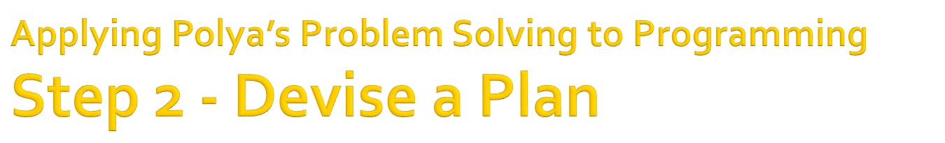
Find connections between the knowns and unknowns.
Simplify: Break the problem into smaller sub-problems
Design a solution
Make a plan or list of actions to implement the solution
  Algorithm / Flowchart / Psuedocode

Slide 29
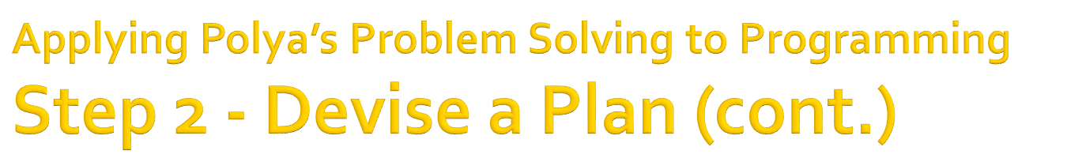
Algorithm
  A FINITE set of clear, executable steps that will eventually terminate to produce the desired outcome
  Logical design used to solve problems – usually a list of actions required to perform task
Pseudocode
  Written like program code but more “English Like” and doesn’t have to conform to language syntax
Flowchart
  Diagram that visually represents the steps to be performed to arrive at solution.

Slide 30
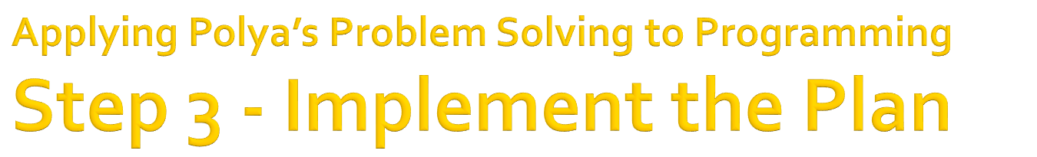
Implement in a Programming Language
Carry out the plan checking the preliminary results at each step.
Code A Little Test A lot

Slide 31

Run the Code
Check results repeatedly and thoroughly
  Use numerous test cases or data sets
  Use highly varied test case, including expected as well as and unexpected cases
Look for new solutions
  Is there a better, easier, or more efficient solution
Can other problems be solved using these techniques?

Slide 32

U - Read the Problem Statement
  Identify the inputs, outputs, and processes
D - Decide how to Solve the Problem
  Create an Algorithm / Flowchart / Psuedocode
I - Program the Code
  Implement in Programming Language
E - Test the Solution
  Run the Code using numerous, varied test cases
Notes:
Reading the Problem and Designing a Plan are important steps in writing programs. The design is a “plan ahead” strategy that will pay off by saving valuable time as programs get increasingly complicated.

Slide 33

Using Polya’s first 2 steps, understand and devise a solution to the following problem:
Determine the week’s earnings for an employee from the hourly pay rate and hours worked for the week. Report the gross earnings (including overtime earnings) for the week.
Definitions:
  Overtime hours = hours over 40
  Overtime pay rate = 1.5 * reg pay rate

Slide 34

Using Polya’s first 2 steps, understand and devise a solution to the following problem:
Determine the week’s earnings for an employee from the hourly pay rate, total hours for the week and tax rate. Report the number of reg hours, overtime hours, gross reg earnings, gross overtime earnings, tax witheld, and total net earnings for the week.
Definitions:
  Overtime hours = hours over 40
  Overtime pay rate = 1.5 * reg pay rate

Slide 35

Write an algorithm to serve as how-to instructions for some relatively simple task or activity. You choose the task, should be 10-20 steps in length. Assume you are writing instructions for someone who has never performed task before.

